Slide 1


Moneyball
and its innovative approach to Baseball
David Falco – 5/2/2018

Slide 2
Background
Popularized by Moneyball: The Art of Winning an Unfair Game
Michael Lewis, 2003
Oakland Athletics 2002 season, their general manager Billy Beane, and his assistant Paul DePodesta
Analytical, evidence-based, sabermetric approach to assembling a competitive baseball team, despite Oakland's disadvantaged revenue situation.
A film based on the book starring Brad Pitt and Jonah Hill was released in 2011.

Slide 3
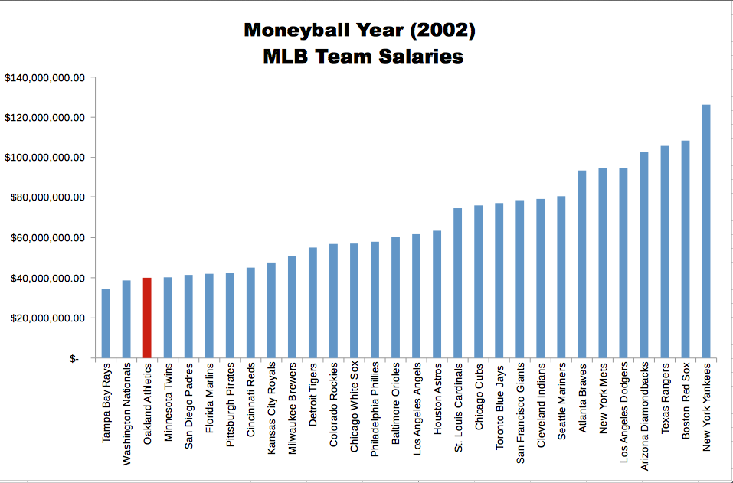
A’s Money Problem

Slide 4
Premise
Conventional wisdom dictated that baseball insiders (including players, managers, coaches, scouts, and the front office) chose teams.
After a century, the practice was found to be subjective and often flawed.
Stats such as stolen bases, RBIs, and batting average, typically used to gauge players in the19th-century were now antiquated
This brought on the rise of sabermetrics, “the application of statistical analysis to baseball records, especially in order to evaluate and compare the performance of individual players.”

Slide 5







Tools used

Slide 6

Just Jupyter Notebook
Was born out of the iPython project and is still “kernel zero”
Is why the extension is .ipynb
Using nb_conda_kernels you can add multiple versions and types of kernels
At the time of writing there are 104! - https://github.com/jupyter/jupyter/wiki/Jupyter-kernels
Notably Julia, Haskell, Ruby, Perl, C, C#, Javascript, Mathematica, MatLab, etc.
It seems this type of presentation is where the scientific community is going
https://www.theatlantic.com/science/archive/2018/04/the-scientific-paper-is-obsolete/556676/
Rise of Wolfram Alpha and Mathematica Notebook made scientific computation interactive
https://github.com/jupyter/jupyter/wiki/A-gallery-of-interesting-Jupyter-Notebooks

Slide 7
Tools and Dataset Used
Python Libraries
pandas
seaborn
matplotlib
numpy
scipy
squarify
MLB Stats 1962 – 2012
Team
League
Year
Runs Scored (RS)
Runs Allowed (RA)
Wins (W)
On-Base Percentage (OBP)
Slugging Percentage (SLG)
Batting Average (BA)
Playoffs (binary)
RankSeason
RankPlayoffs
Games Played (G)
Opponent On-Base Percentage (OOBP)
Opponent Slugging Percentage (OSLG)

Slide 8
Go to Notebook!

Slide 9
Acknowledgements
https://www.kaggle.com/
nikdudaev/what-moneyball-can-tell-us-about-baseball
https://www.kaggle.com/
wduckett/moneyball-mlb-stats-19622012
Lewis M. Moneyball: the Art of Winning an Unfair Game. New York: W.W. Norton; 2003.

